Slide 1

Artist Popularity Study
By: Daniel Brilliant and Ruth Iang

Slide 2

Data Collection
Original dataset contained 25 CSV files:
0000.csv, 0001.csv, 0002.csv, 0003.csv, 0004.csv, 0005.csv, 0006.csv, 0007.csv, 0008.csv, 0009.csv, 0010.csv, 0011.csv, 0012.csv, 0013.csv, 0014.csv, 0015.csv, charts.csv, data_w_spotify.csv, edges_100.csv, feature_core_100.csv, feature_core.csv, final.csv, nodes_100.csv, release_20.csv, and release_100.csv
Not all of the files were relevant for analysis (many repeated information)
Retrieved from: https://www.istockphoto.com/vector/vector-cartoon-illustration-of-stressed-man-or-businessman-overloaded-by-gm1277426194-376641349

Slide 3
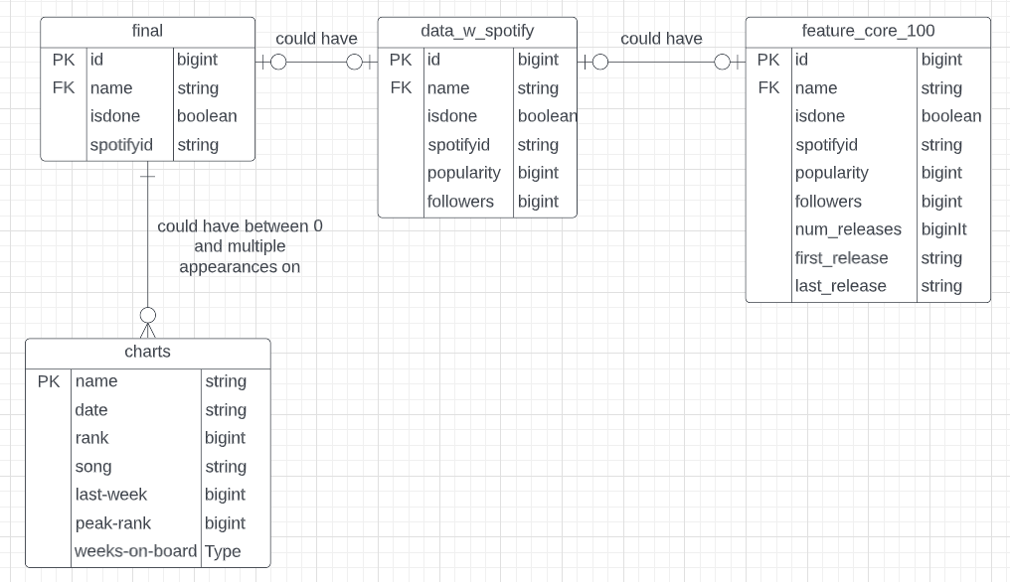
Data Collection
Four CSV files were used for analysis:
final
data_w_spotify
feature_core_100
Charts
The primary key (id) was shared for final, data_w_spotify, and feature_core_100 tables
The primary key for charts (name) is used as a foreign key in the final, data_w_spotify, and feature_core_100 tables
Relationships are optional one to optional one (for final/data_w_spotify and data_w_spotify/feature_core_100) and one to optional many (for final and charts)

Slide 4





AWS Database Development Architecture
Data Warehousing, Querying and Analysis (AWS Redshift)
BI Development and Data Visualization
(Tableau)
Cloud Data Storage (AWS S3)
Serverless ETL
(AWS Glue)
SQL Querying and Analysis (AWS Athena)

Slide 5
Analyzed Factors Influencing an Artist’s Popularity
Popularity indicators
Popularity index
Number of followers
Chart performance
Time between releases/career length
Other factors that were originally listed within the dataset (genres, release dates) were considered, but quality and compatibility was not strong enough for analysis

Slide 6
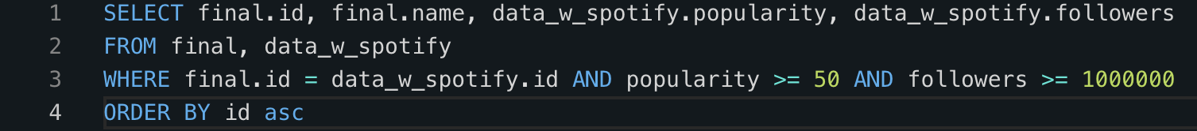
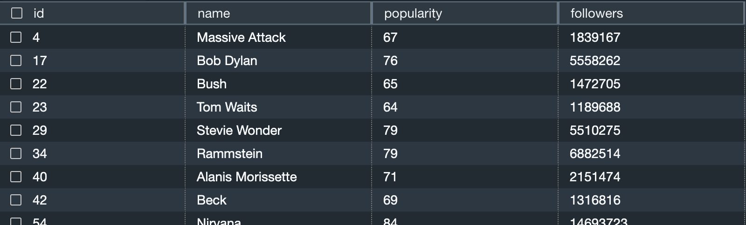
First Query

Slide 7
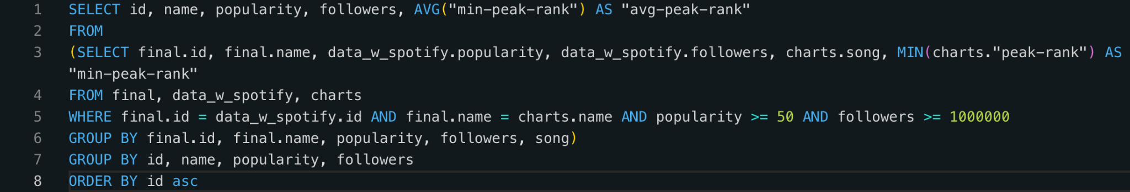
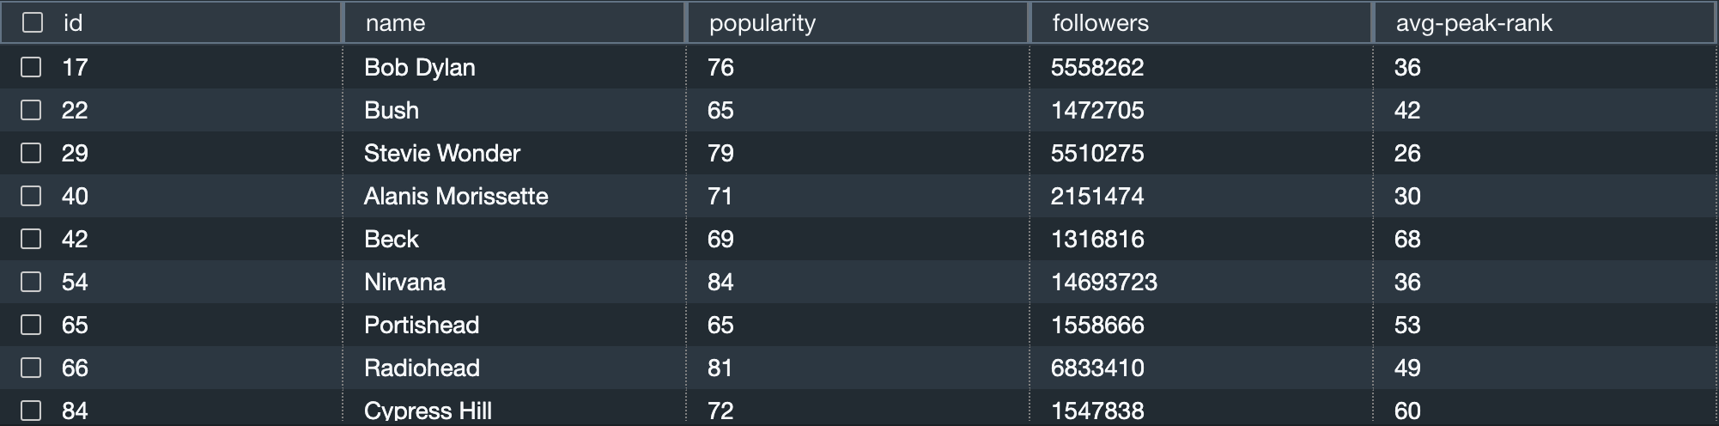
Second Query

Slide 8
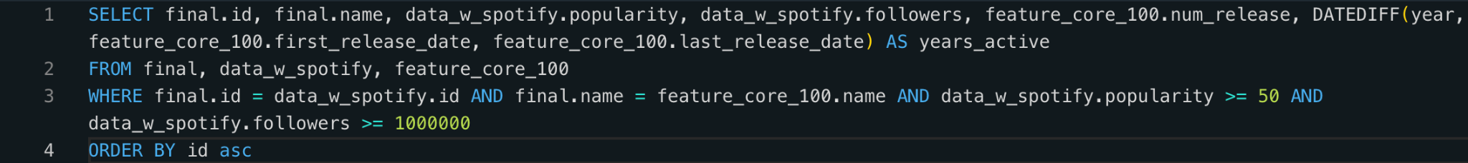
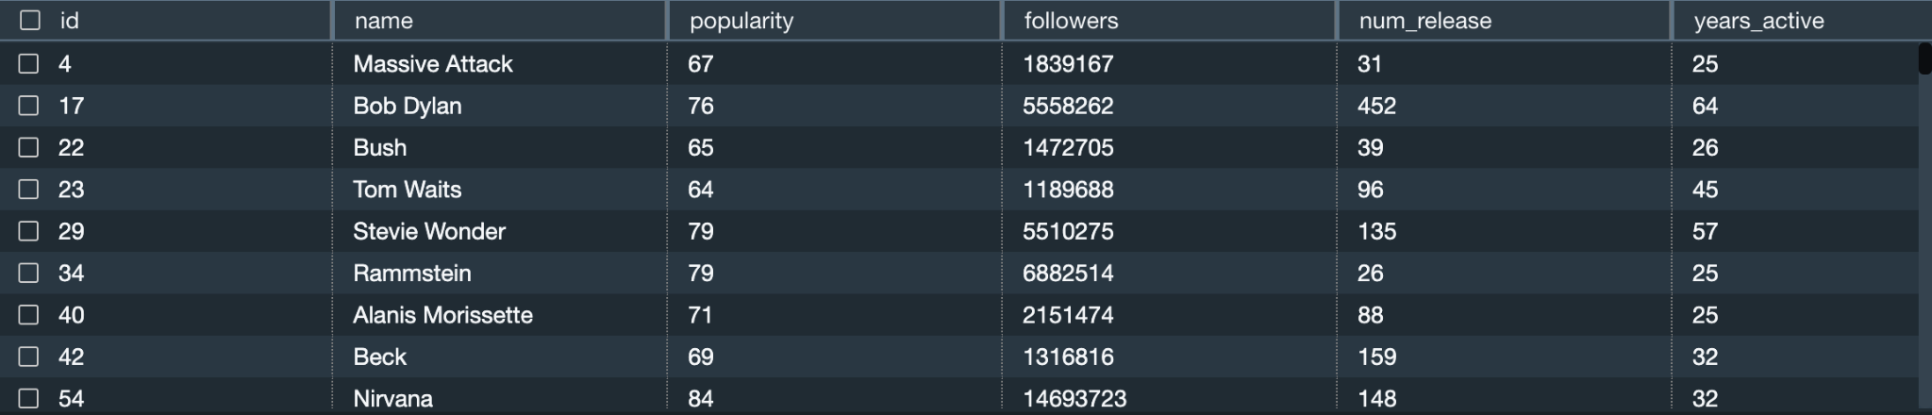
Third Query

Slide 9
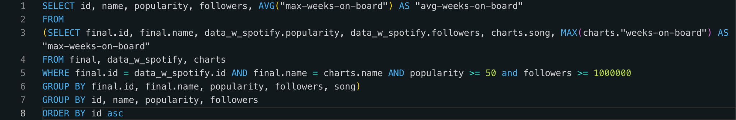
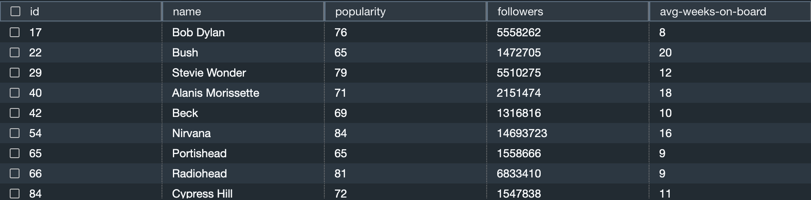
Fourth Query

Slide 10
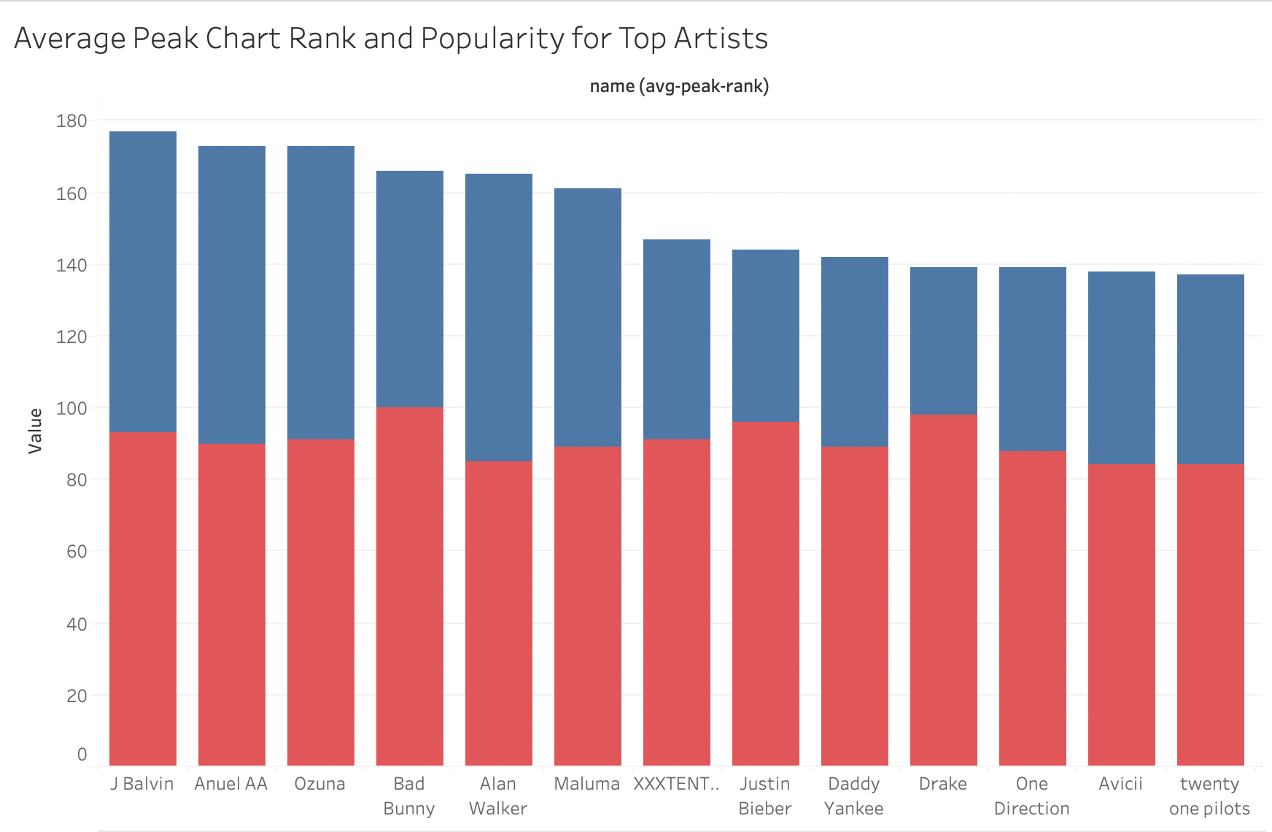
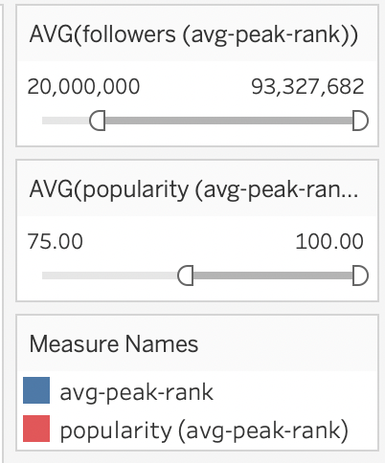
-Average peak is in descending order, but popularity showed a random order
-no relationship

Slide 11
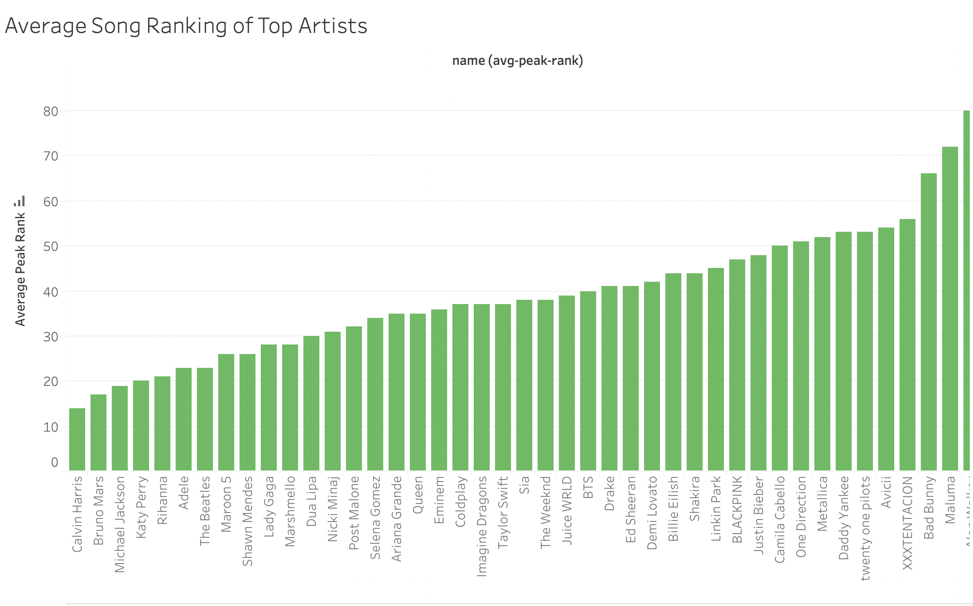
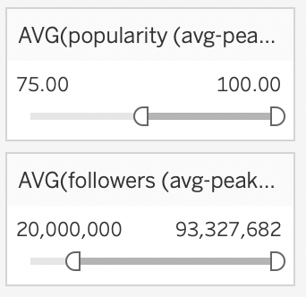
Average Song Ranking of Top Artists
-Calvin Harris had the best charting songs rankings, followed by Bruno Mars

Slide 12
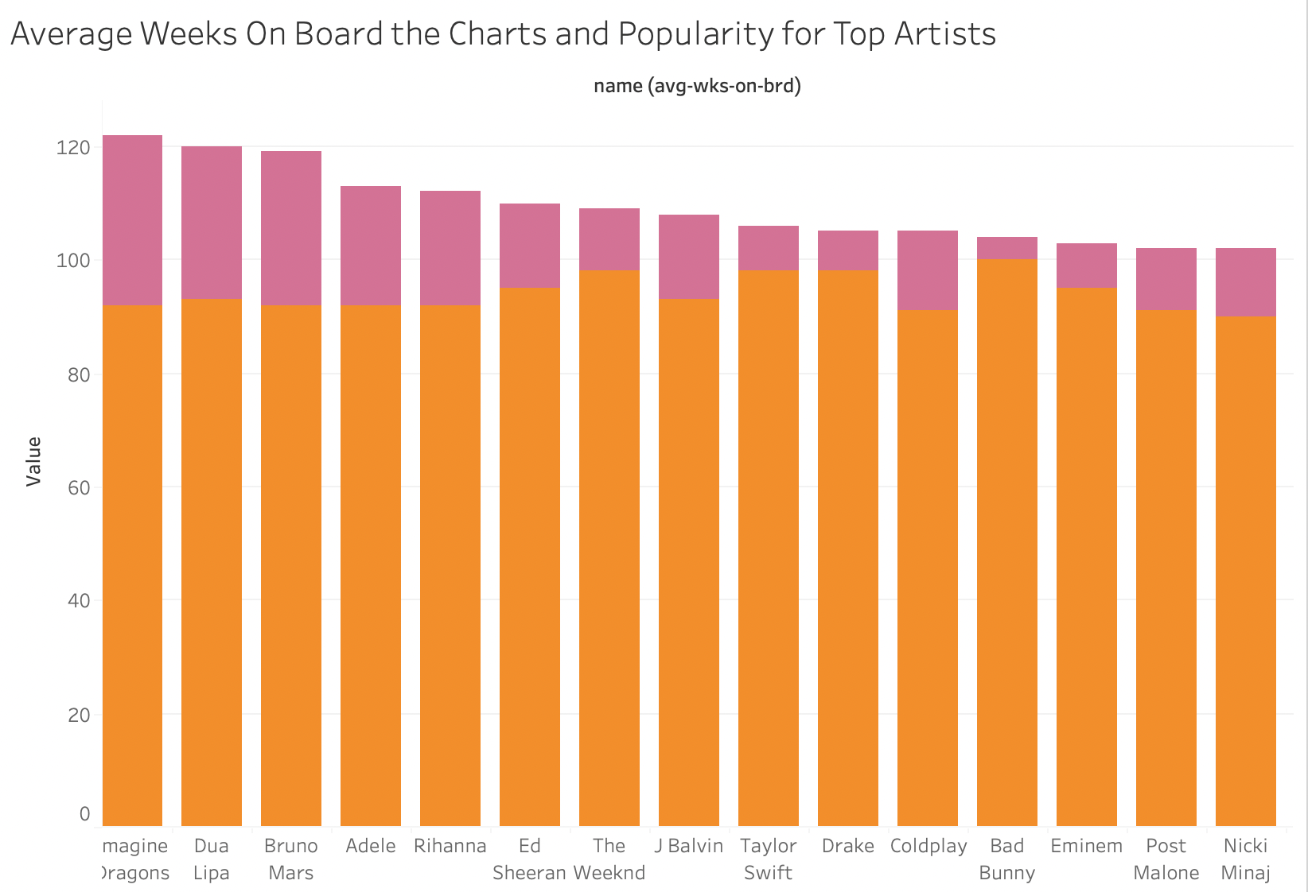
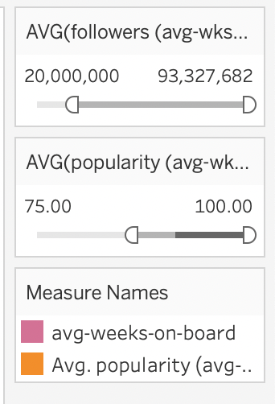
Average Weeks on Board the Charts and Popularity for Top Artists
-Average weeks on board is in a descending order, but average popularity is random
-There is no relationship

Slide 13
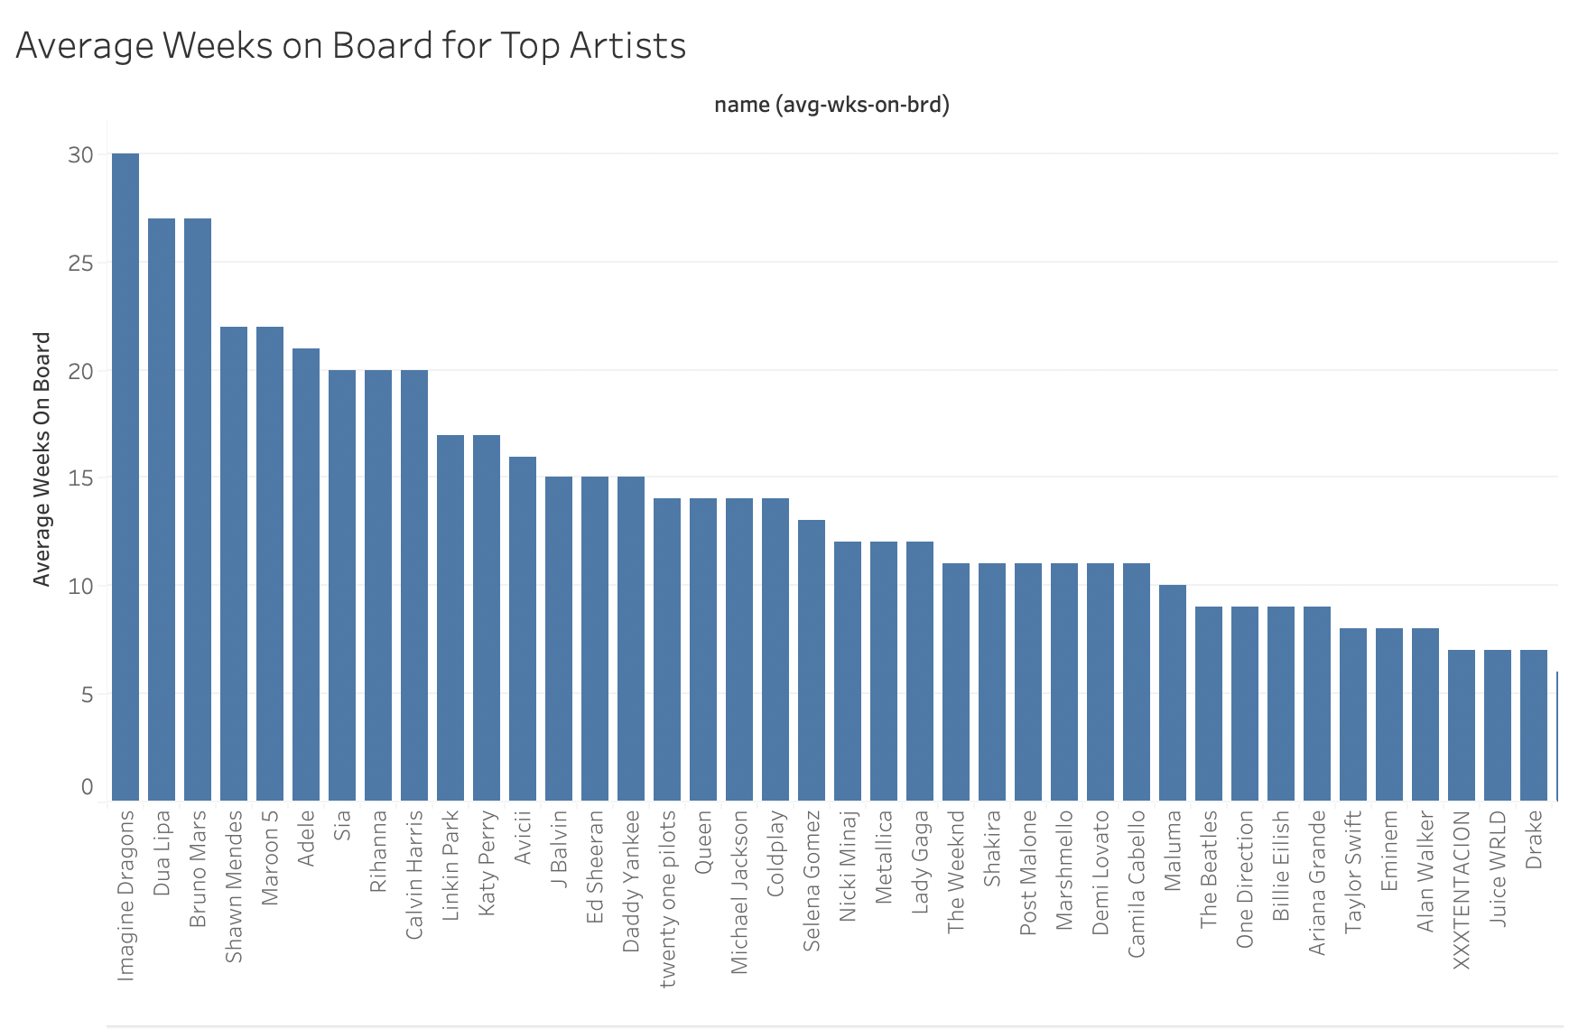
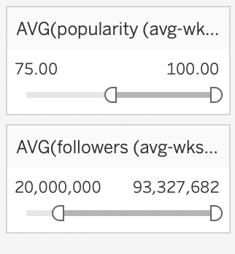
-Shows artists that spend the most time on the charts
-Shows the average weeks on board in a descending order
Average Weeks on Board for Top Artists

Slide 14
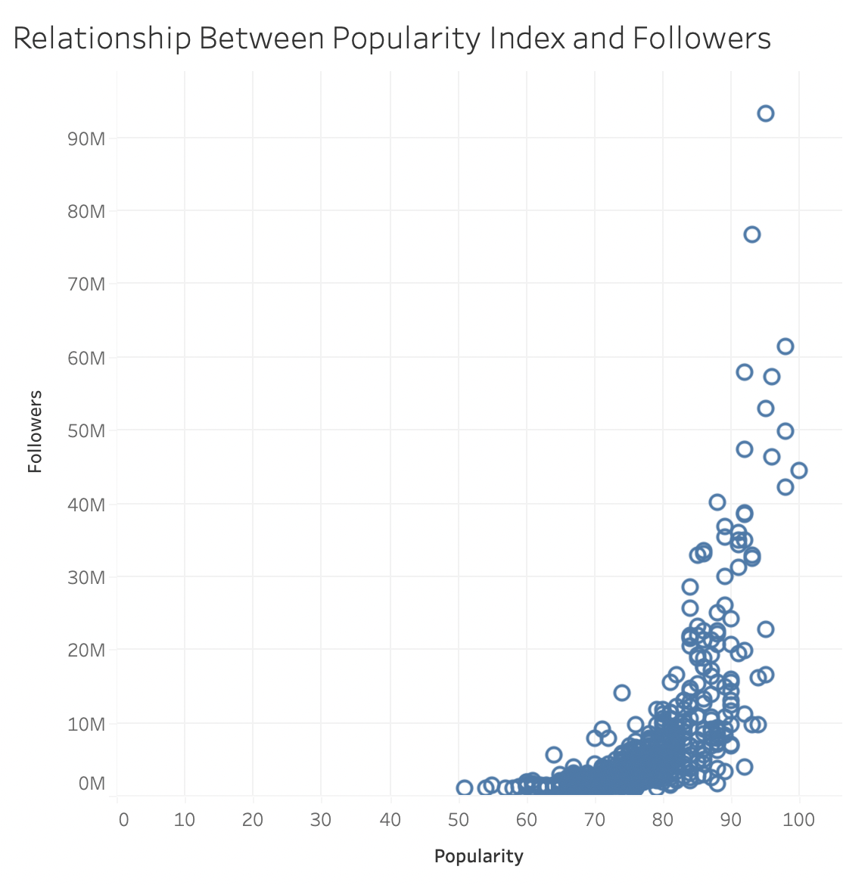
Difference Between Popularity Index and Followers
-Shows a relationship between followers and popularity
-Being more popular results in more followers, which is intuitive
Notes:
-The purpose of subtracting between the latest release and earliest release of a song is too how long they have been active in the industry.
-The scatter plot looks at the relationship between how long an artist has been active in the industry, and the amount of followers they have.
-There is a negative relationship. This means the longer an artist has been active, the less followers they have.

Slide 15
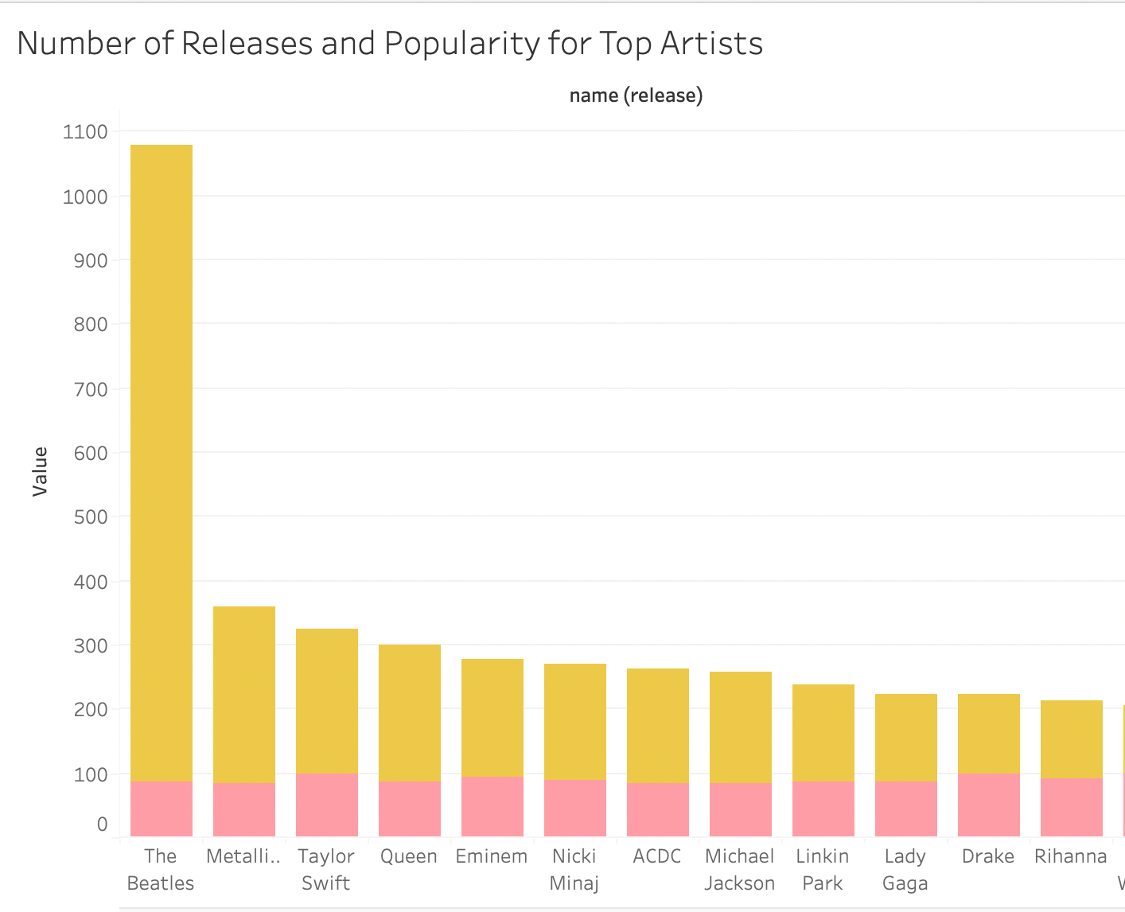
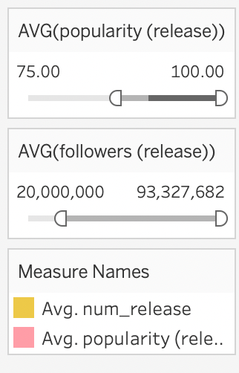
Number of Releases vs Popularity
-Releasing more songs does not make you more popular.
-The Beatles have a lot of songs, and although they were a big deal at one point, they are not as popular today
Notes:
-We believe the number of songs an artist has released affects their popularity and future success
-Created a scatter plot that looks at the relationship between number of releases and popularity.
-The graph show that the more popular an artist is, the more songs they released or if we switched the axis, the higher number of releases an artist has, the more popular they are.

Slide 16
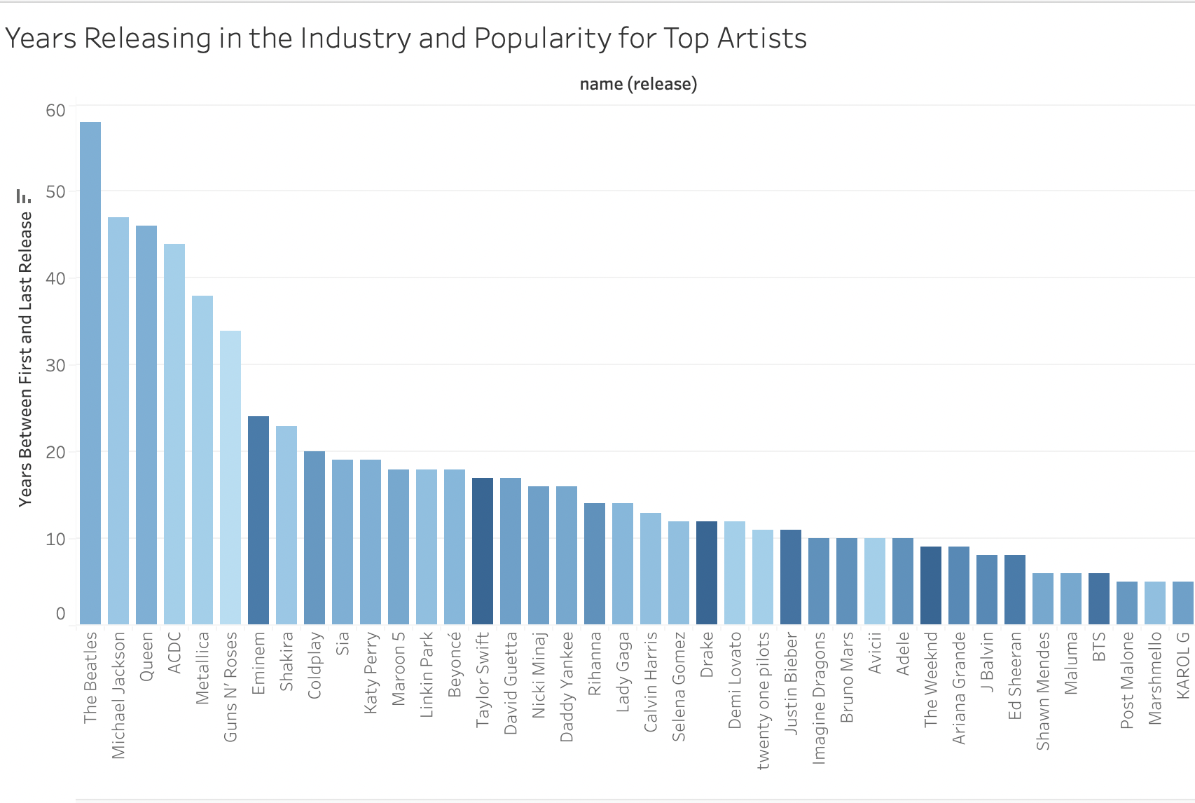
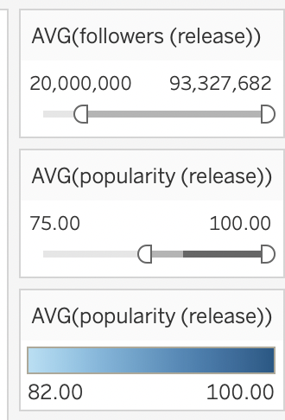
Weeks on Board vs Popularity
-Being in the industry longer does not mean you will be more popular
-The colors should start darkest to lighter as you descend if there was a pattern

Slide 17
Conclusion
Based on the graphs, the only clear trend shown was that an artist’s number of followers had a relationship with their popularity value
Other analysis proved to be inconclusive
Further analysis of other metrics could provide greater insight into what factors make artists more popular on streaming platforms

